Slide 1
Data Analysis and Statistics
Mr. Dipak R. Patil (ME CSE)
Assistant Professor
Department of Computer Engineering

Slide 2
Data categorization
Categorical Data Categorization: Categorical data consists of non-numeric values that represent different categories or groups. Here are common methods of categorizing categorical data:
Nominal Data Categorization: Nominal data represents categories with no inherent order or ranking. Examples include:
Colors (e.g., red, blue, green)
Types of animals (e.g., cat, dog, bird)
Gender (e.g., male, female, non-binary)
Ordinal Data Categorization: Ordinal data represents categories with a meaningful order or ranking. Examples include:
Education levels (e.g., high school, bachelor's, master's)
Customer satisfaction ratings (e.g., very satisfied, satisfied, neutral, dissatisfied, very dissatisfied)
Numerical Data Categorization: Numerical data consists of numeric values and can be categorized based on ranges or intervals. Common methods include:
Discretization: Dividing a continuous numerical variable into discrete intervals or bins. For example, categorizing ages into age groups (e.g., 0-18, 19-35, 36-50, 51+).
Percentiles: Categorizing data based on percentiles, such as quartiles (25th, 50th, and 75th percentiles) or quintiles (20th, 40th, 60th, 80th percentiles). This is often used in finance for portfolio risk assessment.
Custom Categories: Creating custom categories based on specific domain knowledge or requirements. For instance, categorizing income levels into "low income," "middle income," and "high income" based on regional economic standards.
Natural Breaks (Jenks): Using statistical methods to determine natural breaks or clusters in the data. This is commonly employed in geographical mapping and data visualization.

Slide 3
Why Data Categorization is Important:
Simplification: Categorization simplifies complex datasets, making them easier to understand and work with.
Organization: It helps in organizing data for effective storage and retrieval.
Analysis: Categorized data is often easier to analyze, and it facilitates the use of statistical techniques.
Visualization: It supports data visualization and reporting, as categorized data can be presented in charts, graphs, and tables more effectively.
Decision-Making: Categorization aids in decision-making by presenting data in a more interpretable form.
It's important to choose the appropriate categorization method based on the nature of your data and the goals of your analysis. The choice of categories should be meaningful and relevant to the problem you are trying to solve or the insights you are seeking to extract from the data.

Slide 4
Measures of central tendency
Measures of central tendency and measures of dispersion are fundamental concepts in statistics used to describe the characteristics of a dataset. They provide information about the center and the spread of the data. Let's explore these concepts in more detail:
Measures of Central Tendency:
Measures of central tendency represent the "center" or average of a dataset. They provide a single value that summarizes the central or typical value of the data. The three main measures of central tendency are:
Mean (Arithmetic Average): The mean is calculated by adding up all the values in a dataset and then dividing by the number of data points. It is sensitive to outliers.
Mean=∑(i=1to n)xi​​/n
Median: The median is the middle value of a dataset when it is sorted in ascending or descending order. It is not affected by extreme outliers and is often used when the data is not normally distributed.
Mode: The mode is the value that occurs most frequently in a dataset. A dataset can have one mode (unimodal) or multiple modes (multimodal).

Slide 5
Measures of Dispersion (Location of Dispersion)
Measures of dispersion describe the spread, variability, or dispersion of data points in a dataset. They provide insights into how the data is distributed around the central tendency. Common measures of dispersion include:
Range: The range is the simplest measure of dispersion and is calculated as the difference between the maximum and minimum values in the dataset.
Range=Maximum−Minimum Range=Maximum−Minimum
Variance: Variance measures how each data point deviates from the mean. It is calculated by taking the average of the squared differences between each data point and the mean.
Variance=∑(i=1 to n​)(xi​−Mean)2​
Standard Deviation: The standard deviation is the square root of the variance. It provides a more interpretable measure of spread and is often used because it is in the same units as the original data.
Standard Deviation=sqrt of Variance
These measures of central tendency and dispersion are essential tools in statistics for summarizing data, making comparisons, and understanding the distribution of values in a dataset. The choice of which measures to use depends on the specific characteristics of the data and the goals of the analysis.

Slide 6
Basic analysis techniques (Business Intelligence)
What is Data Analysis?
The systematic application of statistical and logical techniques to describe the data scope, modularize the data structure, condense the data representation, illustrate via images, tables, and graphs, and evaluate statistical inclinations, probability data, and derive meaningful conclusions known as Data Analysis. These analytical procedures enable us to induce the underlying inference from data by eliminating the unnecessary confusion created by its rest. Data generation is a continual process; this makes data analysis a continuous, iterative process where the collection and performing data analysis simultaneously. Ensuring data integrity is one of the essential components of data analysis.
There are various examples where data analysis is used, ranging from transportation, risk and fraud detection, customer interaction, city planning healthcare, web search, digital advertisement, and more.
Considering the example of healthcare, as we have noticed recently that with the outbreak of the pandemic, Coronavirus hospitals are facing the challenge of coping up with the pressure in treating as many patients as possible, considering data analysis allows to monitor machine and data usage in such scenarios to achieve efficiency gain.

Slide 7
Why Data Analysis is important?
Data analytics can help you in predicting the strength of your customers at a given time. Using that result, you can sufficiently stock your supplies, in turn, minimizing the loss. In simple words, using data analysis, you can find out the time of the year when your store has the least or the most customers. Using this info, you can stock your supplies accordingly. So these are some reasons why analysis of data is important.
Data Analysis Methods:-
1. Qualitative Analysis
This approach mainly answers questions such as ‘why,’ ‘what’ or ‘how.’ Each of these questions is addressed via quantitative techniques such as questionnaires, attitude scaling, standard outcomes, and more. Such analysis is usually in the form of texts and narratives, which might also include audio and video representations.
2. Quantitative Analysis
Generally, this analysis is measured in terms of numbers. The data here present themselves in terms of measurement scales and extend themselves for more statistical manipulation.
The other techniques include:
3. Text analysis
Text analysis is a technique to analyze texts to extract machine-readable facts. It aims to create structured data out of free and unstructured content. The process consists of slicing and dicing heaps of unstructured, heterogeneous files into easy-to-read, manage and interpret data pieces. It is also known as text mining, text analytics, and information extraction.
The ambiguity of human languages is the biggest challenge of text analysis. For example, humans know that “Red Sox Tames Bull” refers to a baseball match. Still, if this text is fed to a computer without background knowledge, it would generate several linguistically valid interpretations. Sometimes people who are not interested in baseball might have trouble understanding it too.
4. Statistical analysis
Statistics involves data collection, interpretation, and validation. Statistical analysis is the technique of performing several statistical operations to quantify the data and apply statistical analysis. Quantitative data involves descriptive data like surveys and observational data. It is also called a descriptive analysis. It includes various tools to perform statistical data analysis such as SAS (Statistical Analysis System), SPSS (Statistical Package for the Social Sciences), Stat soft, and more.
5. Diagnostic analysis
The diagnostic analysis is a step further to statistical analysis to provide a more in-depth analysis to answer the questions. It is also referred to as root cause analysis as it includes processes like data discovery, mining, and drill down and drill through.
The diagnostic analysis is a step further to statistical analysis to provide a more in-depth analysis to answer the questions. It is also referred to as root cause analysis as it includes processes like data discovery, mining, and drill down and drill through.

Slide 8
Data Analysis Techniques
Techniques based on Mathematics and Statistics
Descriptive Analysis: Descriptive Analysis considers the historical data, Key Performance Indicators and describes the performance based on a chosen benchmark. It takes into account past trends and how they might influence future performance.
Dispersion Analysis: Dispersion in the area onto which a data set is spread. This technique allows data analysts to determine the variability of the factors under study.
Regression Analysis: This technique works by modeling the relationship between a dependent variable and one or more independent variables. A regression model can be linear, multiple, logistic, ridge, non-linear, life data, and more.
Factor Analysis: This technique helps to determine if there exists any relationship between a set of variables. This process reveals other factors or variables that describe the patterns in the relationship among the original variables. Factor Analysis leaps forward into useful clustering and classification procedures.
Discriminant Analysis: It is a classification technique in data mining. It identifies the different points on different groups based on variable measurements. In simple terms, it identifies what makes two groups different from one another; this helps to identify new items.
Time Series Analysis: In this kind of analysis, measurements are spanned across time, which gives us a collection of organized data known as time series.

Slide 9
Statistical hypothesis generation and testing
Statistics is an important part of data science where we use statical assumptions to get assertions from population data, to make assumptions from the population we make hypothesis about population parameters. A hypothesis is a statement about a given problem.
What is Hypothesis Testing
Hypothesis testing is a statistical method that is used in making a statistical decision using experimental data. Hypothesis testing is basically an assumption that we make about a population parameter. It evaluates two mutually exclusive statements about a population to determine which statement is best supported by the sample data.
Example: You say an average student in the class is 30 or a boy is taller than a girl. All of these is an assumption that we are assuming and we need some statistical way to prove these. We need some mathematical conclusion whatever we are assuming is true.
Need for Hypothesis Testing
Hypothesis testing is an important procedure in statistics. Hypothesis testing evaluates two mutually exclusive population statements to determine which statement is most supported by sample data. When we say that the findings are statistically significant, it is thanks to hypothesis testing.

Slide 10
Intelligence Data Analysis
Data intelligence is the use of various tools and methods to analyze and transform data into information from which valuable insight can be drawn.
Intelligent Data Analysis (IDA) is an interdisciplinary study that is concerned with the extraction of useful knowledge from data, drawing techniques from a variety of fields, such as artificial intelligence, high-performance computing, pattern recognition, and statistics. Data intelligence platforms and data intelligence solutions are available from data intelligence companies such as Data Visualization Intelligence, Strategic Data Intelligence, Global Data Intelligence.
What is Intelligent Data Analysis?
Intelligent data analysis refers to the use of analysis, classification, conversion, extraction organization, and reasoning methods to extract useful knowledge from data. This data analytics intelligence process generally consists of the data preparation stage, the data mining stage, and the result validation and explanation stage. ‍
Data preparation involves the integration of required data into a dataset that will be used for data mining; data mining involves examining large databases in order to generate new information; result validation involves the verification of patterns produced by data mining algorithms; and result explanation involves the intuitive communication of results.

Slide 11
Statistical hypothesis generation and testing
Null hypothesis(H0): In statistics, the null hypothesis is a general given statement or default position that there is no relationship between two measured cases or no relationship among groups. In other words, it is a basic assumption or made based on the problem knowledge.
Example: A company production is = 50 units/per day etc.
Alternative hypothesis(H1): The alternative hypothesis is the hypothesis used in hypothesis testing that is contrary to the null hypothesis.
Example: A company’s production is not equal to 50 units/per day etc.
Level of significance It refers to the degree of significance in which we accept or reject the null hypothesis. 100% accuracy is not possible for accepting a hypothesis, so we, therefore, select a level of significance that is usually 5%. This is normally denoted with and generally, it is 0.05 or 5%, which means your output should be 95% confident to give a similar kind of result in each sample.
P-value The P value, or calculated probability, is the probability of finding the observed/extreme results when the null hypothesis(H0) of a study-given problem is true. If your P-value is less than the chosen significance level then you reject the null hypothesis i.e. accept that your sample claims to support the alternative hypothesis.

Slide 12
Steps in Hypothesis Testing
Step 1– We first identify the problem about which we want to make an assumption keeping in mind that our assumption should be contradictory to one another
Step 2 – We consider statical assumption such that the data is normal or not, statical independence between the data.
Step 3 – We decide our test data on which we will check our hypothesis
Step 4 – The data for the tests are evaluated in this step we look for various scores in this step like z-score and mean values.
Step 5 – In this stage, we decide where we should accept the null hypothesis or reject the null hypothesis

Slide 13
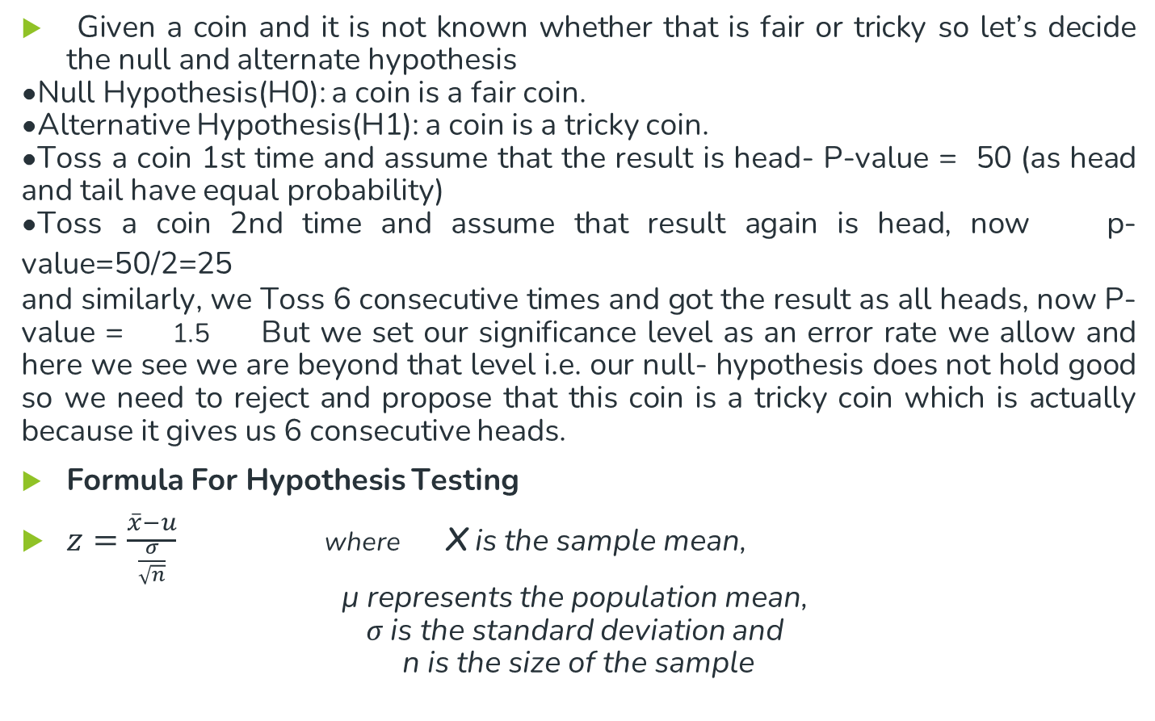
Example:
.
Given a coin and it is not known whether that is fair or tricky so let’s decide the null and alternate hypothesis
Null Hypothesis(H0): a coin is a fair coin.
Alternative Hypothesis(H1): a coin is a tricky coin.
Toss a coin 1st time and assume that the result is head- P-value = 50 (as head and tail have equal probability)
Toss a coin 2nd time and assume that result again is head, now p-value=50/2=25
and similarly, we Toss 6 consecutive times and got the result as all heads, now P-value = 1.5 But we set our significance level as an error rate we allow and here we see we are beyond that level i.e. our null- hypothesis does not hold good so we need to reject and propose that this coin is a tricky coin which is actually because it gives us 6 consecutive heads.
Formula For Hypothesis Testing
$z=\frac{\overline{x}−u}{\frac{σ}{\sqrt{n}}}$ where x is the sample mean,
μ represents the population mean,
σ is the standard deviation and
n is the size of the sample

Slide 14
Statistical hypothesis testing method
Statistical hypothesis testing involves several methods and techniques to assess the validity of hypotheses about population parameters or relationships within a dataset. The choice of method depends on the type of data, research question, and the nature of the hypotheses being tested.
Z-Test and T-Test:
Z-Test: Used when the population standard deviation is known.
T-Test: Used when the population standard deviation is unknown, and sample size is small (typically < 30).
Paired T-Test: Used to compare means of two related groups (e.g., before and after an intervention).
Independent Samples T-Test: Used to compare means of two independent groups.
Chi-Squared Test:
Chi-Squared Goodness of Fit Test: Used to assess if observed data matches a theoretical distribution (e.g., expected vs. observed counts).
Chi-Squared Test for Independence: Used to examine the independence of two categorical variables in a contingency table.
Analysis of Variance (ANOVA):
One-Way ANOVA: Used to compare means of three or more independent groups to determine if there are significant differences.
Two-Way ANOVA: Used when there are two independent variables to assess their combined effects on a dependent variable.

Slide 15
Regression Analysis:
Simple Linear Regression: Examines the relationship between a dependent variable and one independent variable.
Multiple Linear Regression: Explores the relationship between a dependent variable and multiple independent variables.
Logistic Regression: Used for binary or categorical dependent variables to predict probabilities.
Nonparametric Tests:
Wilcoxon Rank-Sum Test (Mann-Whitney U Test): Used to compare two independent groups when data does not meet the assumptions of parametric tests.
Kruskal-Wallis Test: A nonparametric alternative to one-way ANOVA for comparing three or more independent groups.
Fisher's Exact Test:
Used for small sample sizes or when the chi-squared test is inappropriate, especially for 2x2 contingency tables.
Correlation Analysis:
Pearson's Correlation Coefficient: Measures the strength and direction of a linear relationship between two continuous variables.
Spearman's Rank Correlation: Measures the strength and direction of a monotonic relationship between two variables.
Analysis of Covariance (ANCOVA):
Combines analysis of variance (ANOVA) and regression analysis to examine group differences while controlling for one or more continuous covariates.

Slide 16
Intelligent data analysis
Intelligent data analysis, nature of data
Intelligent Data Analysis (IDA) is one of the most important approaches in the field of data mining.
Based on the basic principles of IDA and the features of datasets that IDA handles, the development of IDA is briefly summarized from three aspects :
Algorithm principle
The scale
Type of the dataset
Intelligent Data Analysis (IDA) is one of the major issues in artificial intelligence and information.
Intelligent data analysis discloses hidden facts that are not known previously and provide potentially important information or facts from large quantities of data.
It also helps in making a decision.
Based on machine learning, artificial intelligence, recognition of pattern, and records and visualization technology, IDA helps to obtain useful information, necessary data and interesting models from a lot of data available online in order to make the right choices.
IDA includes three stages:
(1) Preparation of data
(2) Data mining
(3) Data validation and Explanation

Slide 17
Analytic Processes and Tools
Analytic processes and tools
Big Data Analytics is the process of collecting large chunks of structured/unstructured data, segregating and analyzing it and discovering the patterns and other useful business insights from it.
These days, organizations are realizing the value they get out of big data analytics and hence they are deploying big data tools and processes to bring more efficiency in their work environment.
Many big data tools and processes are being utilized by companies these days in the processes of discovering insights and supporting decision making.
Big data processing is a set of techniques or programming models to access large- scale data to extract useful information for supporting and providing decisions.
Below is the list of some of the data analytics tools used most in the industry :
R Programming (Leading Analytics Tool in the industry)
Python
Excel
SAS
Apache Spark
Splunk
RapidMiner
Tableau Public
KNime

Slide 18
Analysis v/s Reporting
Analysis vs reporting
Reporting :
Once data is collected, it will be organized using tools such as graphs and tables.
The process of organizing this data is called reporting.
Reporting translates raw data into information.
Reporting helps companies to monitor their online business and be alerted when data falls outside of expected ranges.
Good reporting should raise questions about the business from its end users.
Analysis :
Analytics is the process of taking the organized data and analyzing it.
This helps users to gain valuable insights on how businesses can improve their performance.
Analysis transforms data and information into insights.
The goal of the analysis is to answer questions by interpreting the data at a deeper level and providing actionable recommendations.
Conclusion :
Reporting shows us “what is happening”.
The analysis focuses on explaining “why it is happening” and “what we can do about it”.

